Slide 1
The Game The cards as narrative stimuli
GRAZIA CHIARINI – SARA CALCINI
LUA

Slide 2
Life is a game
If we think about our adventures and tell them to some friends or relatives, we realize that our life has been like a kind of game. A game made of many matches, now won, now lost.
When we write down our memories, we put them one after the other, aligning them like the cards of a game, on a table.

Slide 3
Life as a set of events
We play with our memories and realize that we are making a kind of script, like in a movie.
Some memories are pleasant, some are painful, some are beautiful, others are hidden even without knowing it.
Life as a set of events, plots, ups and downs, falls and shooting, stops and new departures is comparable to the games and plots of a comedy.

Slide 4
A game we can play many times
No memory is an exact copy of what really happened.
What we write on a memory can be expanded, modified.
An autobiography can be rewritten so many times.
The Game My Life can be played many times, in many different ways and in different contexts.

Slide 5
Psychological scientific studies tell us that:
Personal revelation of self is not only good for our emotional health, but also increases our physical health.
Suppressing internal problems requires a devastating toll on the health, affects the immune system.
It is never too late to heal old emotional wounds
Opening Up by Writing it down: how expressive writing improves Health and Eases Emotional Pain James W. Pennebaker (2016)

Slide 6
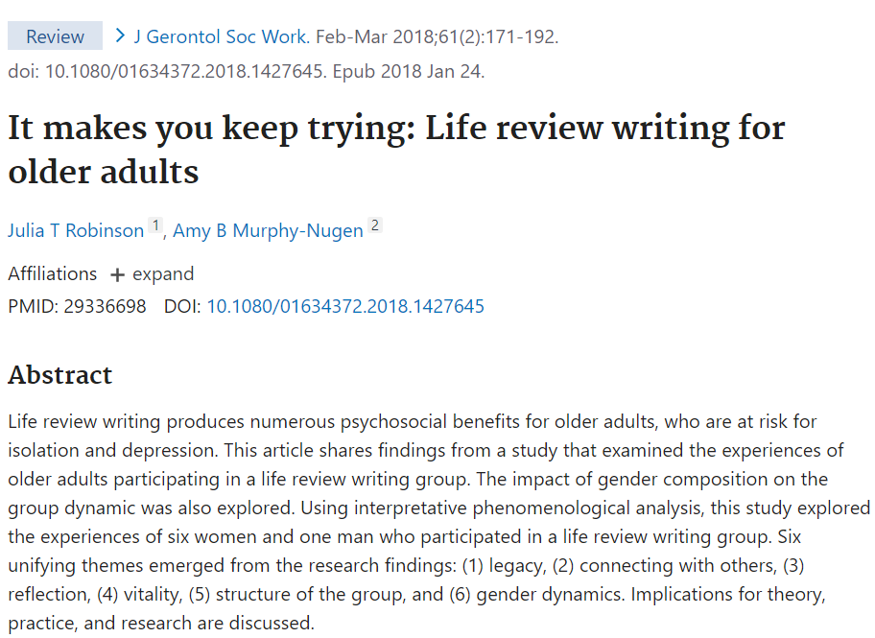
Writing for older adults
Life review writing produces numerous psychosocial benefits for older adults. who are at risk for isolation and depression.

Slide 7
All this happens, in a narration and writing group, if the master follows some rules.
He/she has:
experienced My Life Game personally in the various versions, flexibility, respect, active listening, not judgment, care of others, knowledge that the time of communication is a time of care (Italian law 219/2017)

Slide 8
The pedagogical objectives of the working group
Learning to listen/observe/perceive carefully
Improve self-awareness, emotions and the mechanisms of constructing meanings.
Developing the exploration of different points of view
Acceptance of diversity
Exercise empaty Put yourself in the shoes of the other.

Slide 9
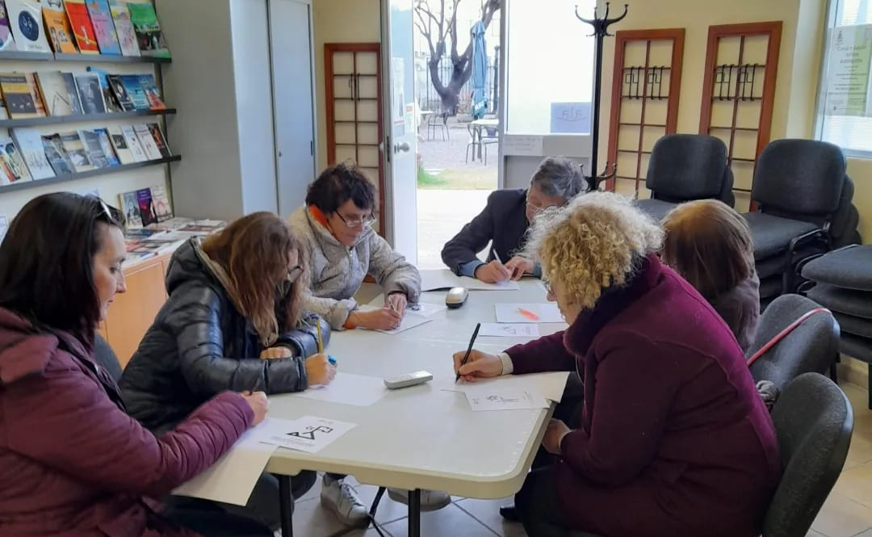
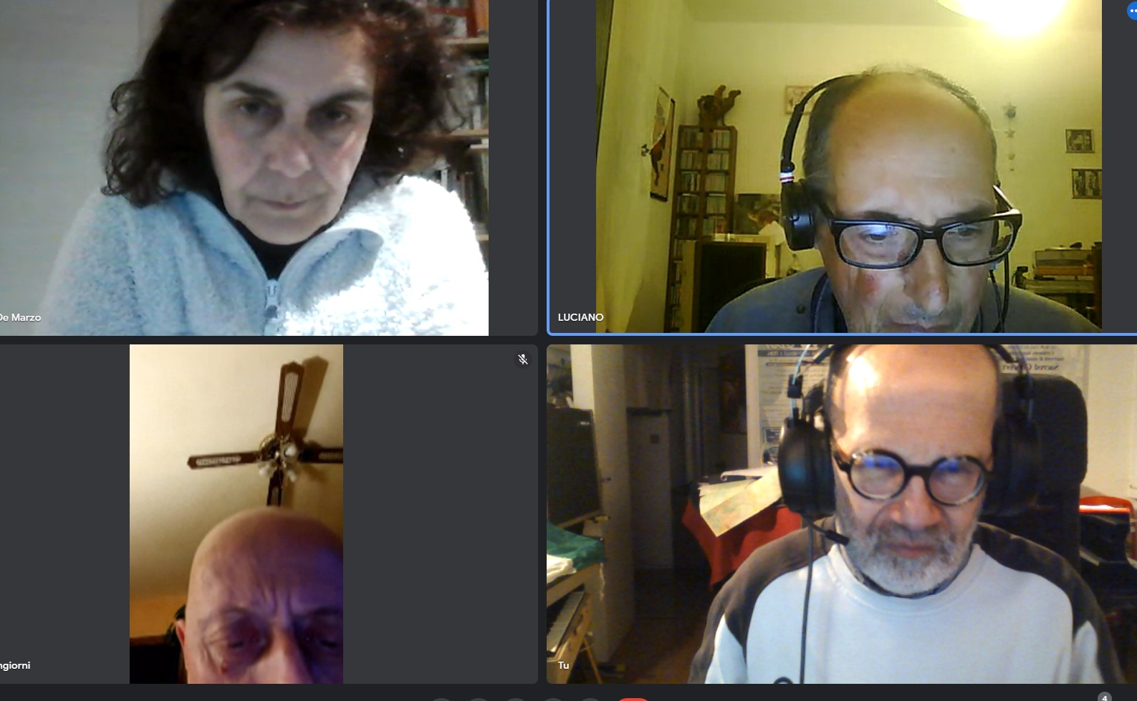
The stages of a group meeting with changes depending on the context
All participants present themselves saying their name.
The master presents himself/herself , the Project, the chosen game, the methodology, the number of meetings of the path, questionnaires to be completed before and after the game path.
Group rules: confidentiality, not judgment, listening, free sharing, respect for each other.

Slide 10
Invitation to writing, without forcing. The Master can give indications on the duration time of a writing if necessary. Example 4-5 minutes or more
Invitation to share contents with reading aloud of the writings. If there is not enough time to share all the writings the Master asks participants to say three keywords of their writing. Reception of the emotions and reflections of the various participants At the end of the game : the Master asks participants how they felt to write about themselves, what emotions they felt, what doubts. The master gives directions for the next meeting.

Slide 11
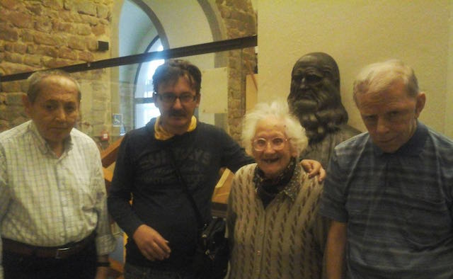
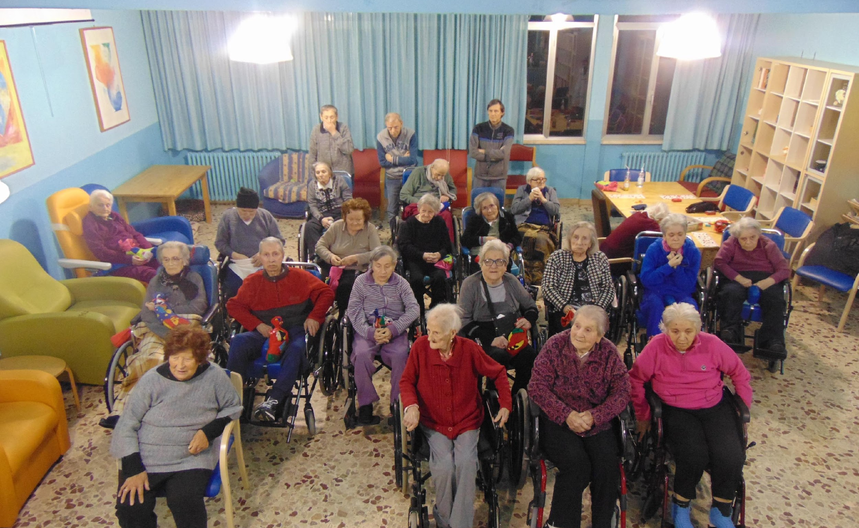
The positive effects of writing in very older adults.
The older adults has accumulated many experiences.
The story of themselves opens a space for reflection that also helps to rediscover the sense of their choices.
The positive effects of writing are to be able to materialize thoughts and emotions, allowing the person to process them.

Slide 12
Some aspects of group play with older people
The older people who make up the group, depending on their specificity, the present resources, the preferences they manifest, indicate to the master the rules to follow.
The path must be sewn on the person.
The environment that welcomes the group must be suitable, protected from noise and the coming and going of people. The light and temperature in the room, all helps to make the meeting place cozy.

Slide 13
Some aspects of group play with older people
The master invites people to position themselves where they prefer inside a circle or around a table, even those who are in a wheelchair, with delicacy and respect.
Very old people should not be too numerous: hearing and visual difficulties, if present, should not invalidate participation, listening should not be too tiring.
With seniors who have cognitive problems the master can open the pages of the past but without forcing. The important that he/she can express what he wants freely.

Slide 14
If we want to write our autobiography…
We reread our writings and we give them an order and a sense.
For example a chronological time order: memories of childhood, of adulthood, of senility.
For each period read what we wrote: the beautiful or bad moments, people known, family, adventures, desires, expectations. Is something missing? Shall we add something?
Our story describes an individual life in its evolution, in its connections with social, historical, public events.

Slide 15
If we want to write our autobiography…
We can also ask questions, think over our writings with an introspective vision.
Who I am? Do I recognize myself in my stories? Have I achieved the goals I wanted to achieve? What have I learned?
With the 64-card deck it is easier to write an introspective autobiography because it contains various stimuli of a reflexive type.

Slide 16
Our autobiography may have the guise of a:
novel of training
novel of adventure
mystery novel
love novel
novel of travel
philosophical essay
intimate novel
experiential chronicle
poetic prose

Slide 17
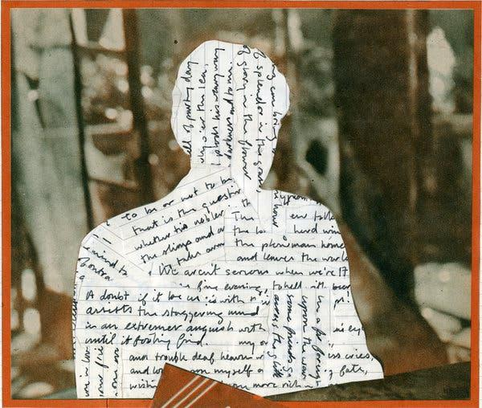
The essential plot of an autobiography
INCIPIT : my life begins ( things, events, faces, noises, reflections, people, facts)
RUIT : My life runs ( education, the family, childhood environments, adult figures, peers, games, crisis, breakups, turns, desires, budgets, meetings, passions)
EXIT : My life ends for the moment ( results achieved, not achieved, future programs)
I

Slide 18
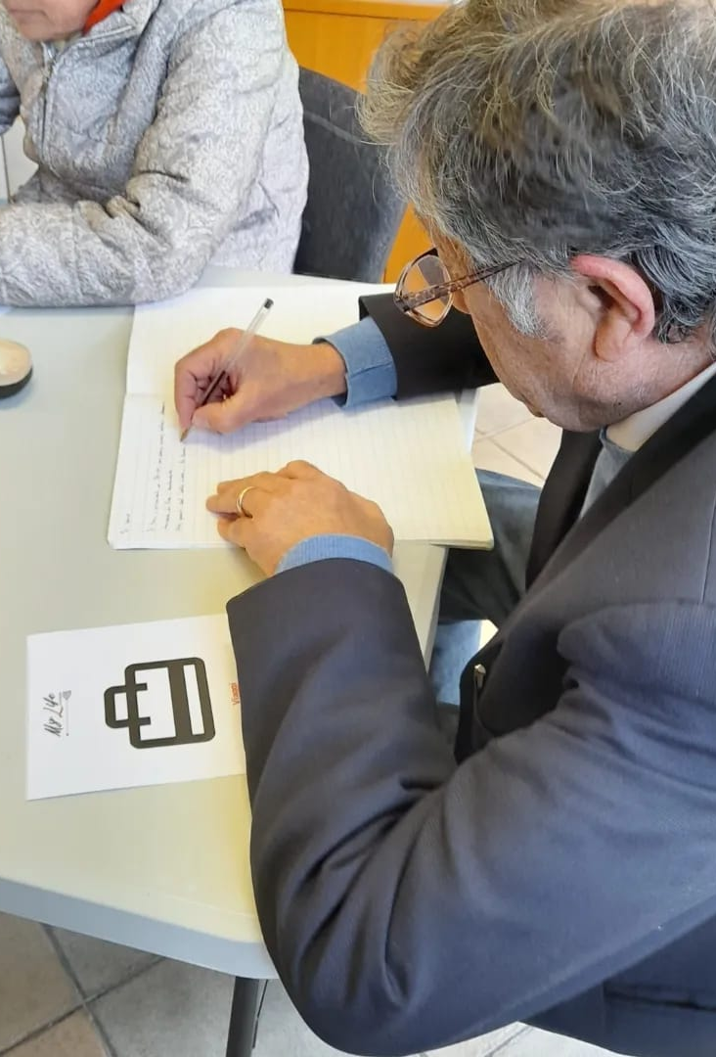
My Life The Game
It has some features of cognitive games and serious games:
Use cards as stimuli to write.
It has structured activity with a path that allows you to get to the end of the game.
It has simple instructions.
It allows you to acquire new skills or consolidate those present (how to play online games).
It allows to measure the progress achieved. (cards used, written products). It favors the valorization and the gratification tied to the task.

Slide 19
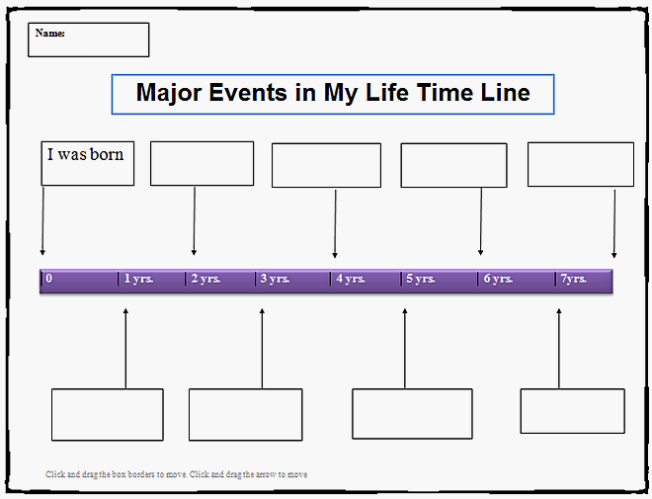
My Life The Game
The stimuli of the cards have a chronological disposition from the first memory to the adult age, a TimeLine.
You can find specific topics to write about: work, studies, health, love, dark events and so on.
At the end of the game we can save our writings in PDF.

Slide 20
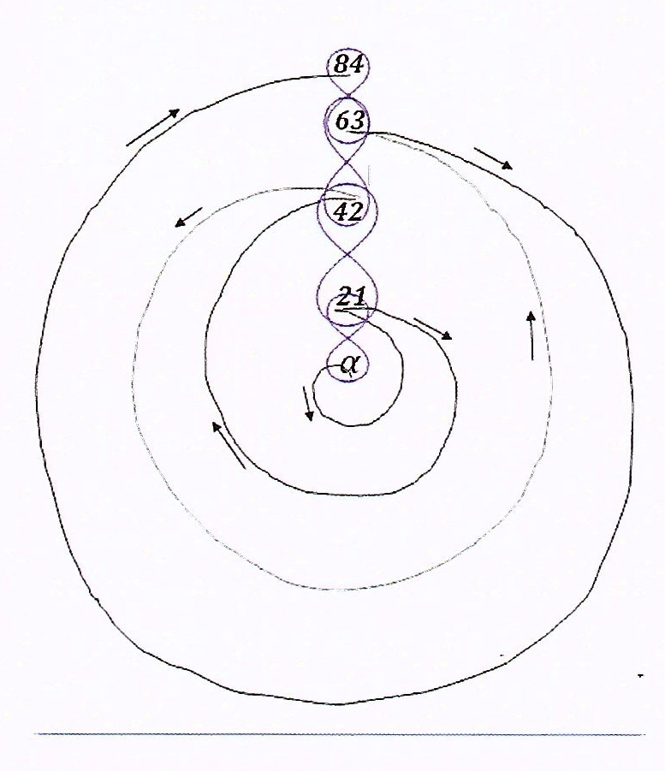
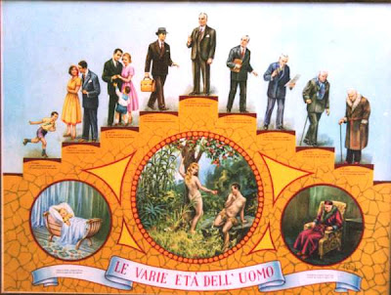
Other graphic symbols representing human life
Spiral
Scale
Pyramid

Slide 21
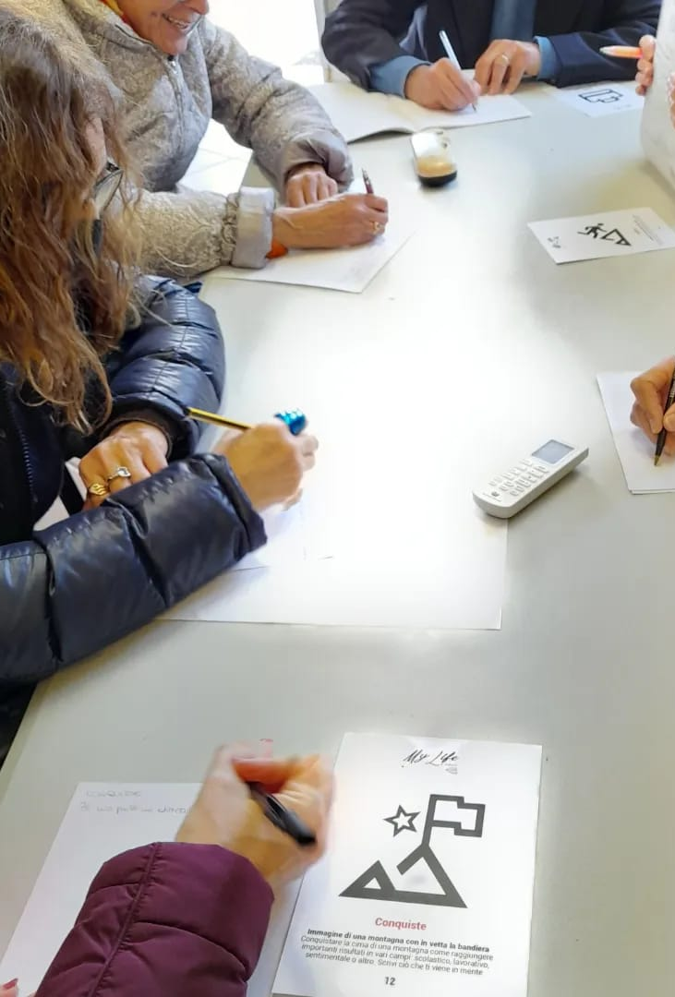
The cards of the Game
The cards are solicitations that have to bring back memories and events that happened during life.
The images and the words are deliberately essential.
There is a description of the image for the blinds.
There are some writing proposals to start.
We can find other proposals on the manual.
Players write and then proceed in the game.
Memories can be short sentences, autobiographical fragments, sensory memories, facts.

Slide 22
To make a deck of cards we have chosen:
The number of cards
The contents of the cards
The name of the deck
The theme of the deck

Slide 23
We can choose a number of cards with a symbolic meaning but it is not mandatory
64 cards : 64 is the number of boxes in the Game of the Goose, a spiral. 64 is symbol of Unity, towards which the path must lead us (6+4=10; 1+0=1).
22 cards : 22 is the number of the major arcana of the Tarot, cards of ancient origin with psychological implications, studied by Carl Gustav Jung and Alejandro Jodorowsky. 12 cards : The European flag consists of a circle of 12 golden stars on a blue background. The number 12 is a symbol of perfection and wholeness.

Slide 24
The name of the deck
the number of cards
a fancy name
A metaphor
Related to the theme we chose (a period of life, work, illness, school, European identity ...)

Slide 25
The theme of the deck
My life the Game has as main theme the writing of episodes of life according to a chronological order from the past to the present, with a linear trend.
On each card, however, we can write about different periods of our life.
Within this path we can find some main categories of reference:
Time : childhood, youth, adulthood, retirement, past, present, future
Space: rooms, houses, cities, landscapes, countries

Slide 26
The theme of the deck
Bodies/figures/faces :family members, teachers, mentors, friends, loves
Actions/ facts : play, travel, read, study, stop, dream
Emotions:episodes linked to particular emotions ( joy, sadness, anger, fear)
Sensory perceptions : tastes, sounds, tactile, visual perceptions, smells
Objects: backpack, book, various objects

Slide 27
Which deck to choose?
It depends on the time we want to dedicate to the game, the writing, the type of players, the context.
The 64-card deck offers more opportunities to explore more aspects of our life story. It takes more time to get to the end of the game. Suitable for a round of matches.
With the 22-card deck we will arrive in less time at the end of the game. Also suitable for a single match. It can be used in the first trial of the game.
We can build new decks

Slide 28
The deck of 64 cards
Each card contains:
A number
An image
A word related to the image
A brief description of the image
In the case of photos with multiple elements choose the element we want to highlight

Slide 29
The deck of 64 cards
A proposal for writing. Open-Ended questions are better.
An open-ended question is a question that cannot be answered with a "yes" or "no" answer. open-ended questions require a longer answer.
Other proposals are in the manual or indicated by the master or we can write what we want.

Slide 30
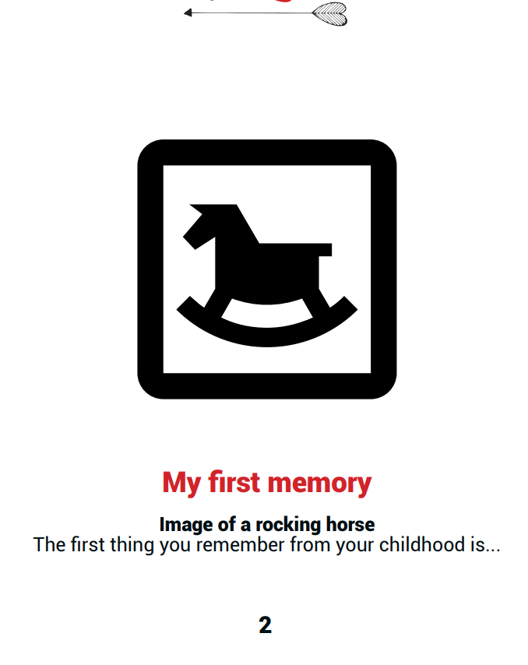
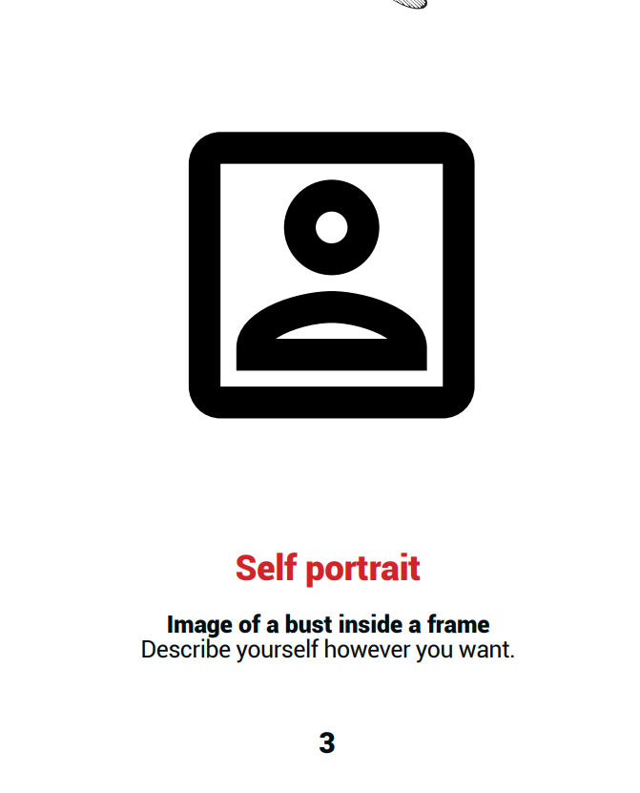
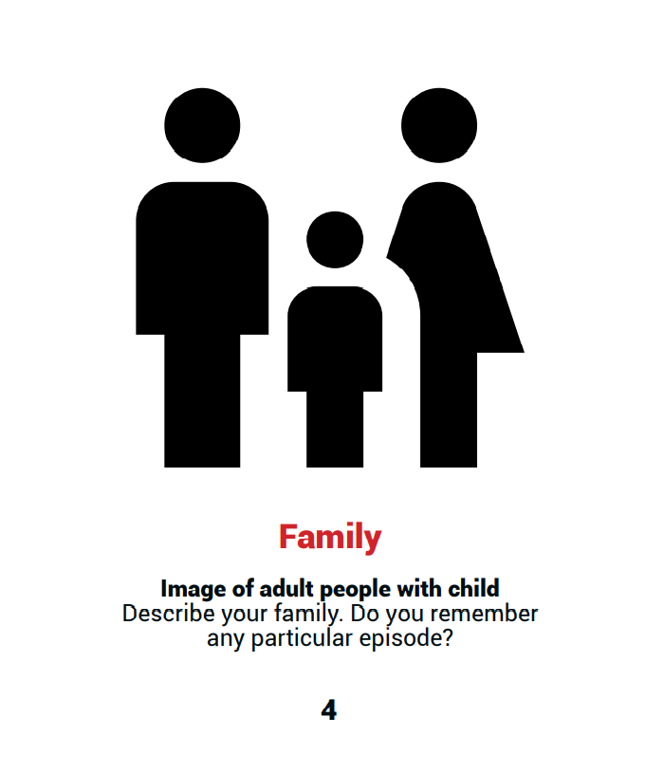
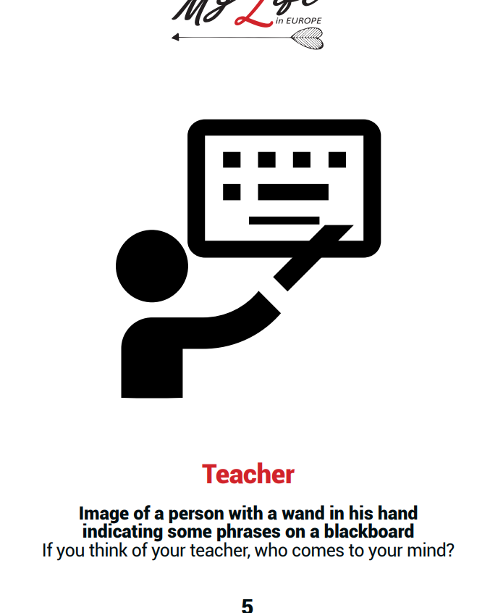
In the 64 deck the first sixteen cards explore memories of childhood and early adolescence. Words and images have a clear meaning. In addition to the writing proposals of the card we can write on family holidays, recipes of food, habits and so on.

Slide 31
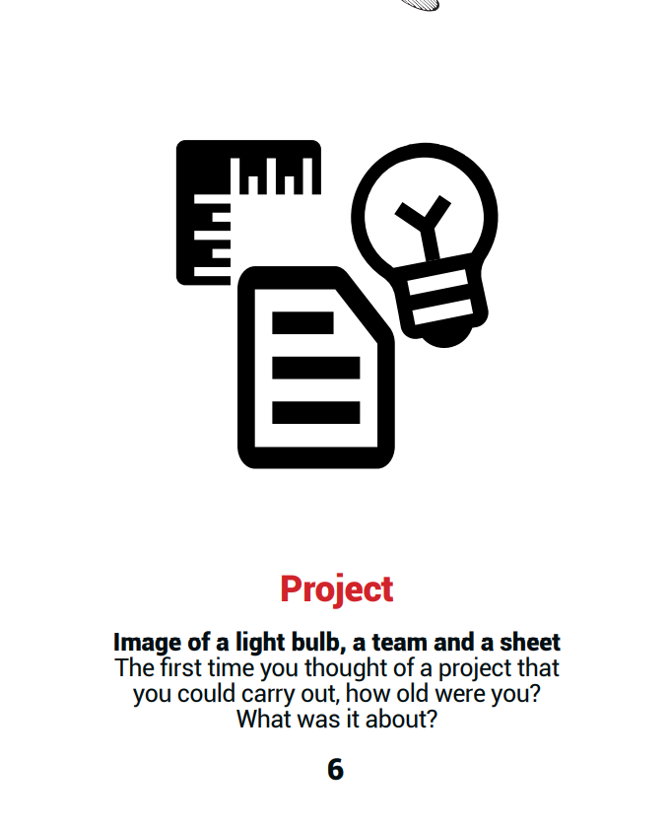
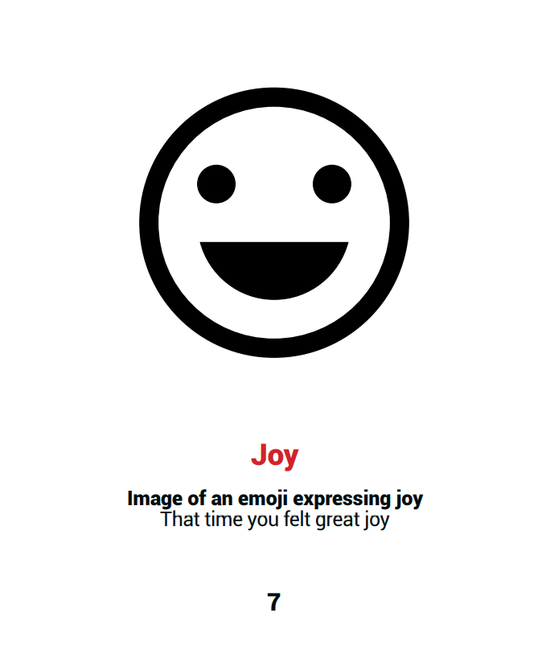
On each stimulus we can still write memories of other ages of life

Slide 32
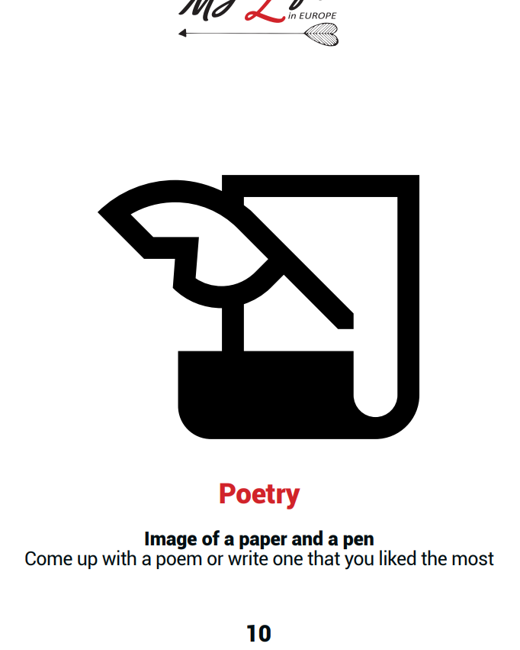
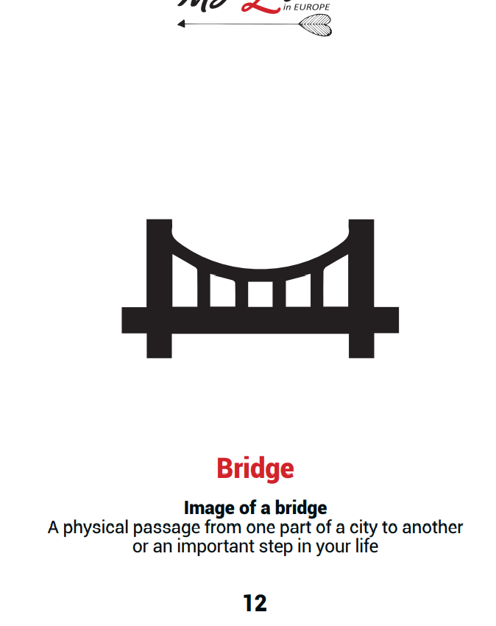
The bridge in this case can represent the transition from childhood to adolescence. What happened? What changes?

Slide 33
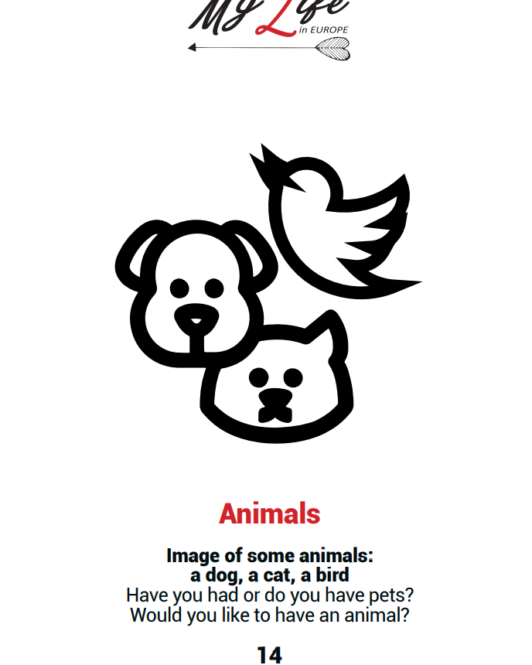
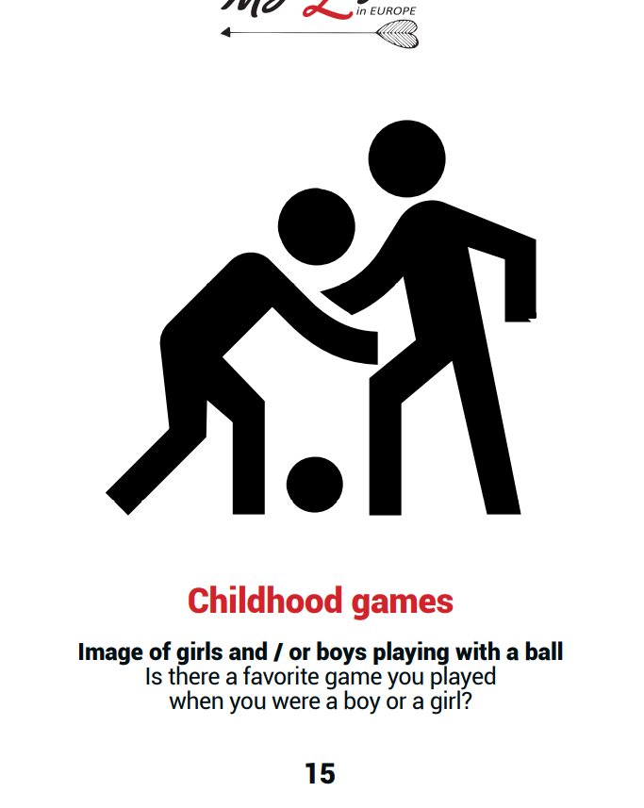
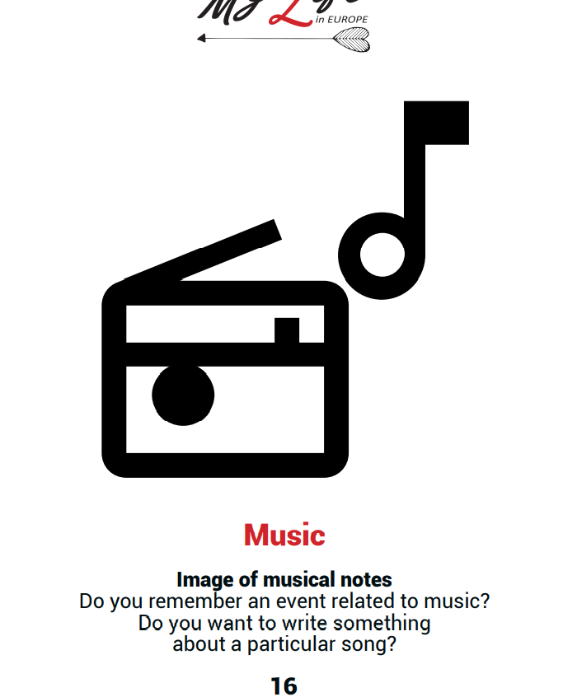
Also on these stimuli we can write memories of other ages of life

Slide 34
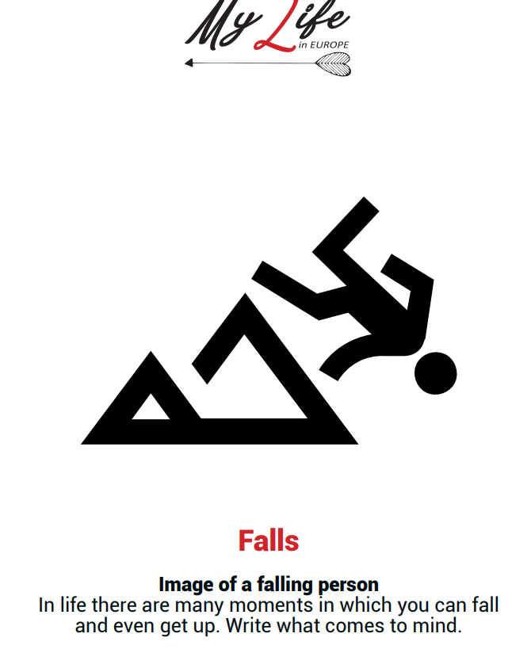
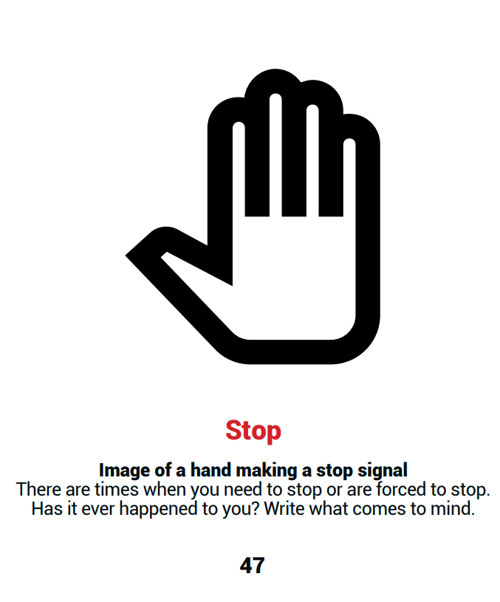
Some images and words have a darker sense. More space is given to personal interpretation and metaphorical use of the figure. These cards stimulate more the reflection.

Slide 35
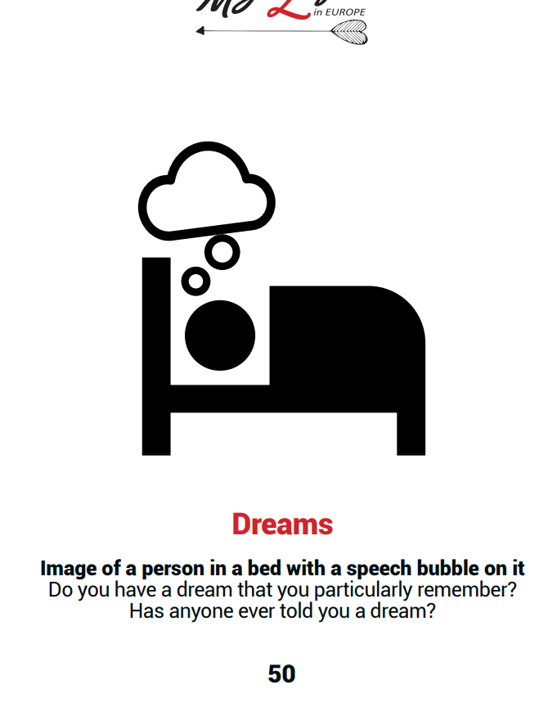
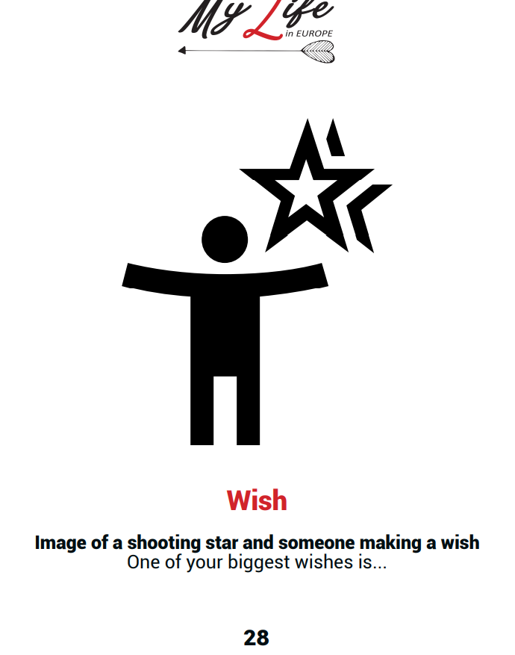
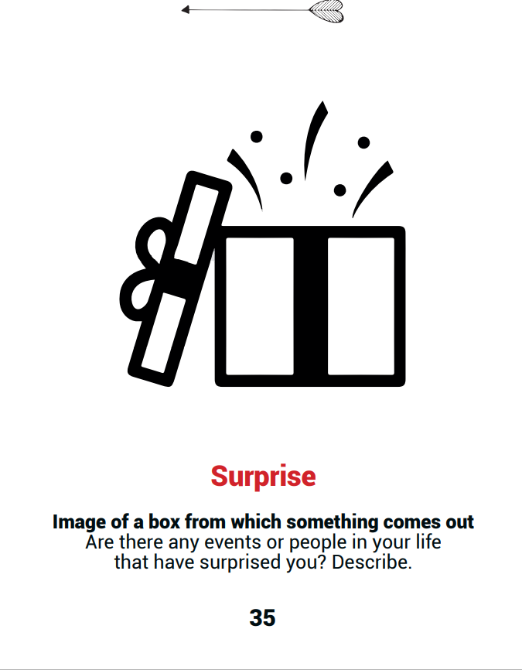
The proposal under the card is one of the many possible on which to write. We can write what we want.

Slide 36
Some stimuli allow us to take a look at the whole path of life

Slide 37
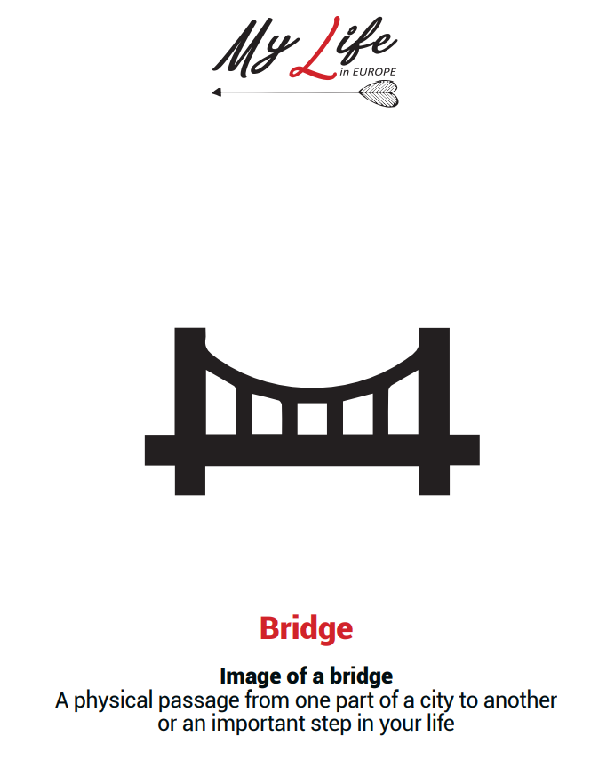
Some cards indicate a transition from one situation to another

Slide 38
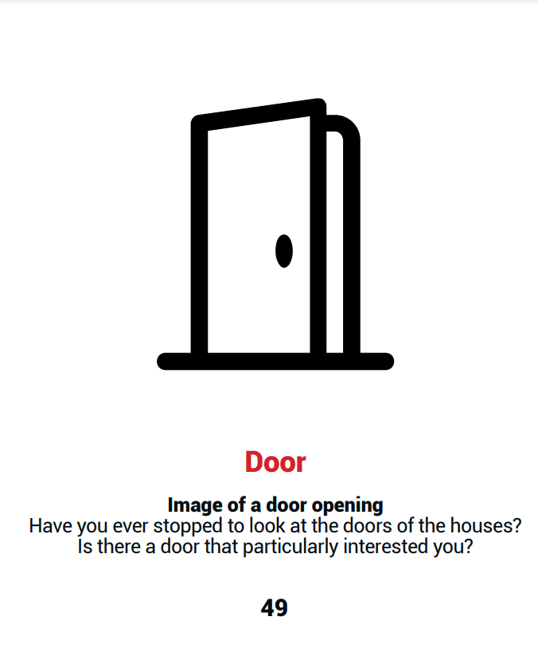
Some cards indicate a transition from one situation to another

Slide 39
The center of the Finish line is also a new beginning

Slide 40
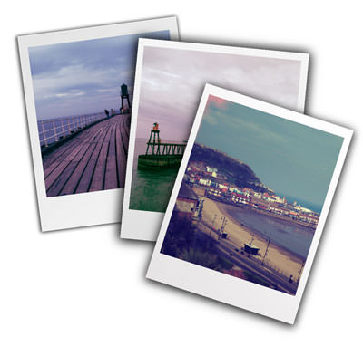
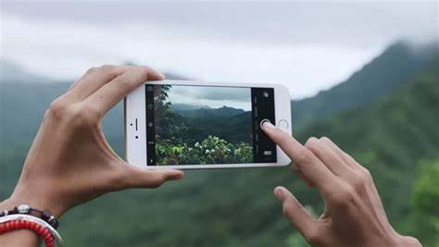
The writing on the way in search of images and new stories for a new deck

Slide 41
A new chance to build our cards
Each group of participants together with the master will find places to go, stop to write and take pictures.

Slide 42
In this case the places and the photos chosen will represent the stimuli to write
For each photo will be chosen a word that characterizes it,
as in the MYLIFE card deck

Slide 43
ATTENTION
Photos of faces or recognizable people, not belonging to the group, will not be used.
Photos on details of the place or places identified may be a new deck of cards of “MY LIFE” to use

Slide 44
The cards of Romania
Material : photos taken during the first LTT in Ramnicu Valcea and Sibiu in Romania in July 2021
Photo contents: some details of the cities and highlights of the experience.
The choice of the photo and the word must stimulate the imagination.
In the choice of the photo we must ask ourselves: what does this image suggest to me? Are there other meanings? In comparison with others we can know more meanings.

Slide 45
The cards of Romania
Objective: to stimulate the memory thanks to the solicitation of the photos with different themes.
Identified categories : Time, Space, Figures/Actions/Objects
Number of cards : 22
Short description of the photo
Proposals to write: open questions are preferable

Slide 46
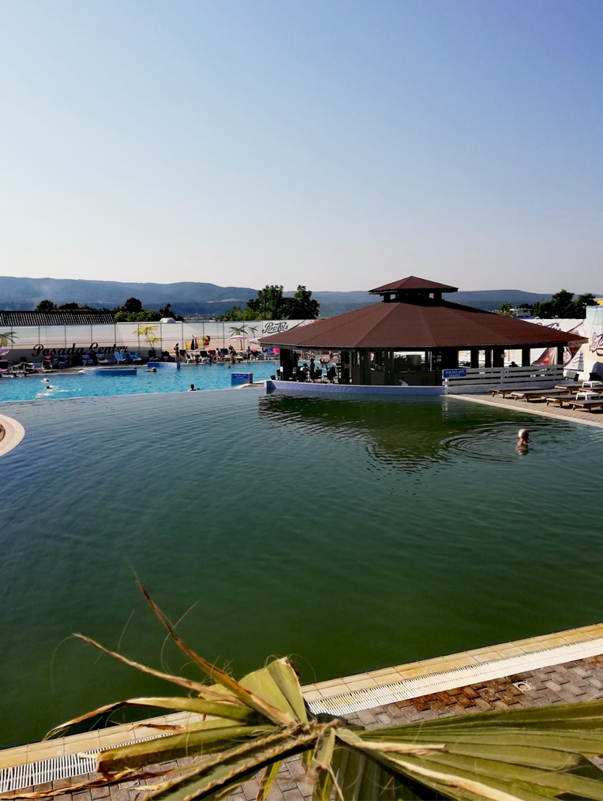
Swimming pool
Image of a swimming pool with some people swimming.
That time that …
When you came to that beautiful place…
Note: the hotel pool is my first photo on arrival. Metaphorically it could mean swimming in memory in search of memories.

Slide 47
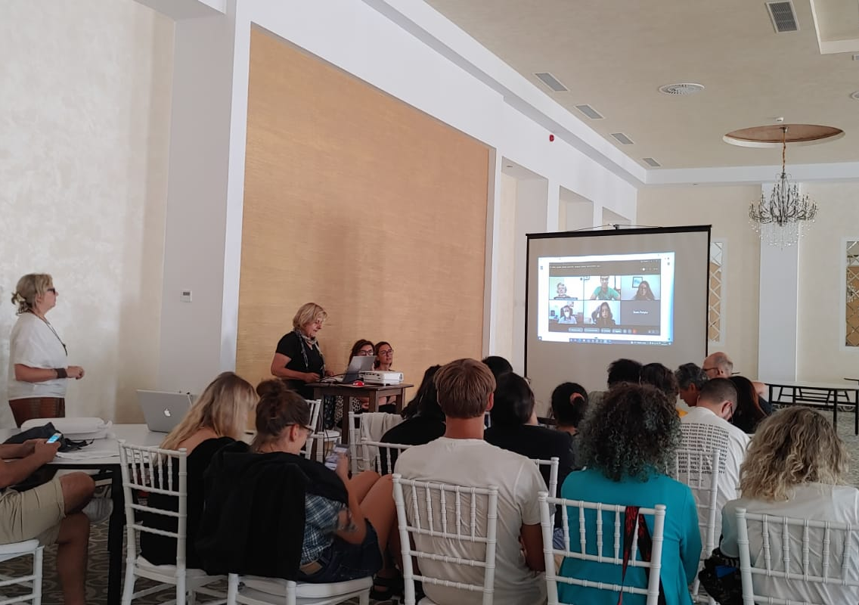
Study Meeting
Image of many people in a room looking at a screen and a person talking.
Do you remember your first day of study? What did you feel? Who were you with?
I

Slide 48
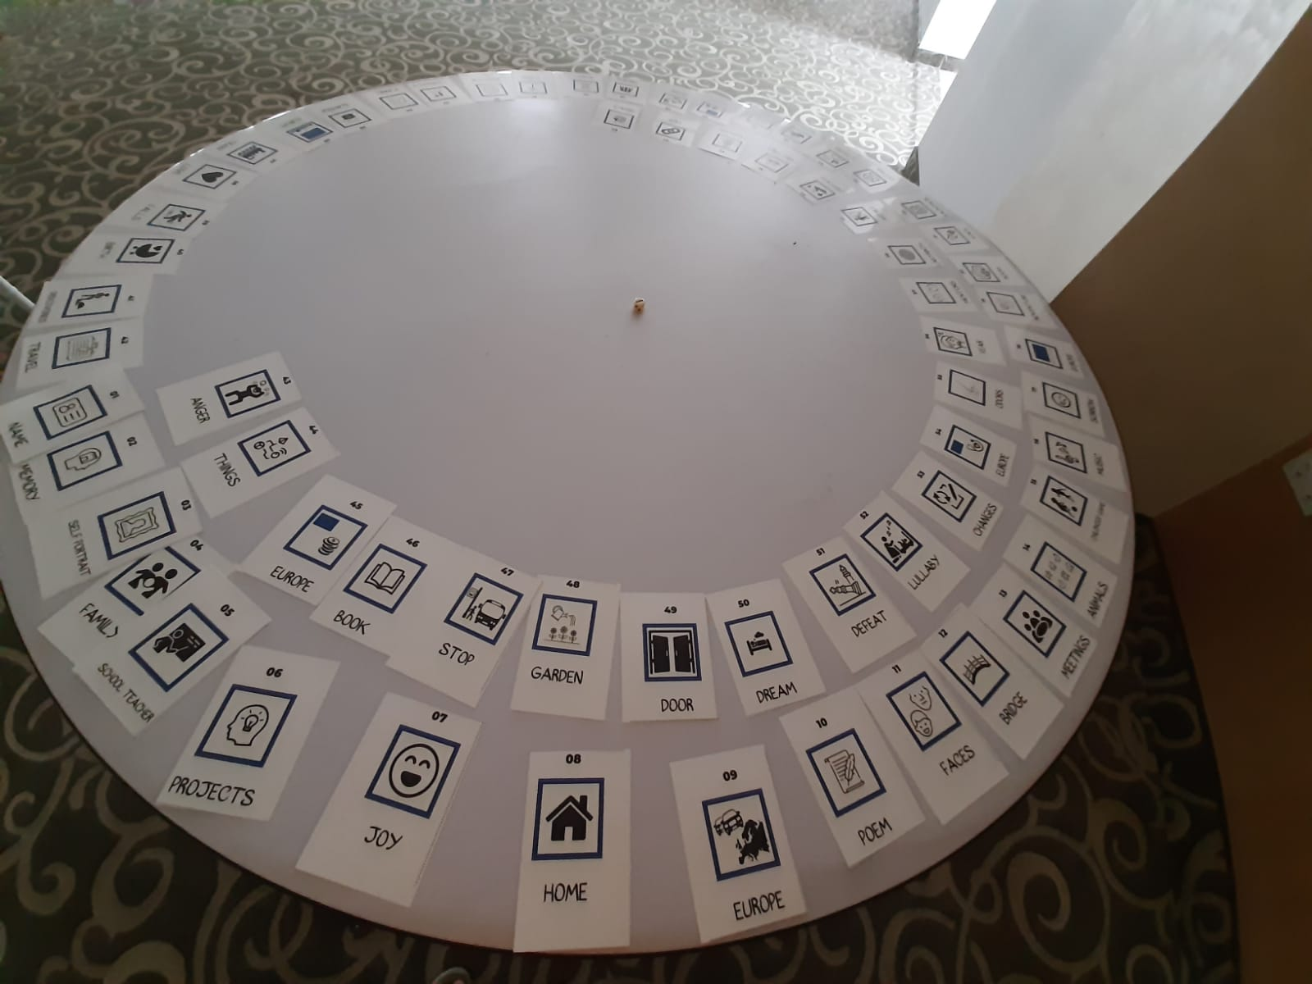
Games
Image of a round table with cards arranged in spiral and a dice.
Your first gaming experience. Write what comes to mind.
Note : this is the first version of My Life 64 card game

Slide 49
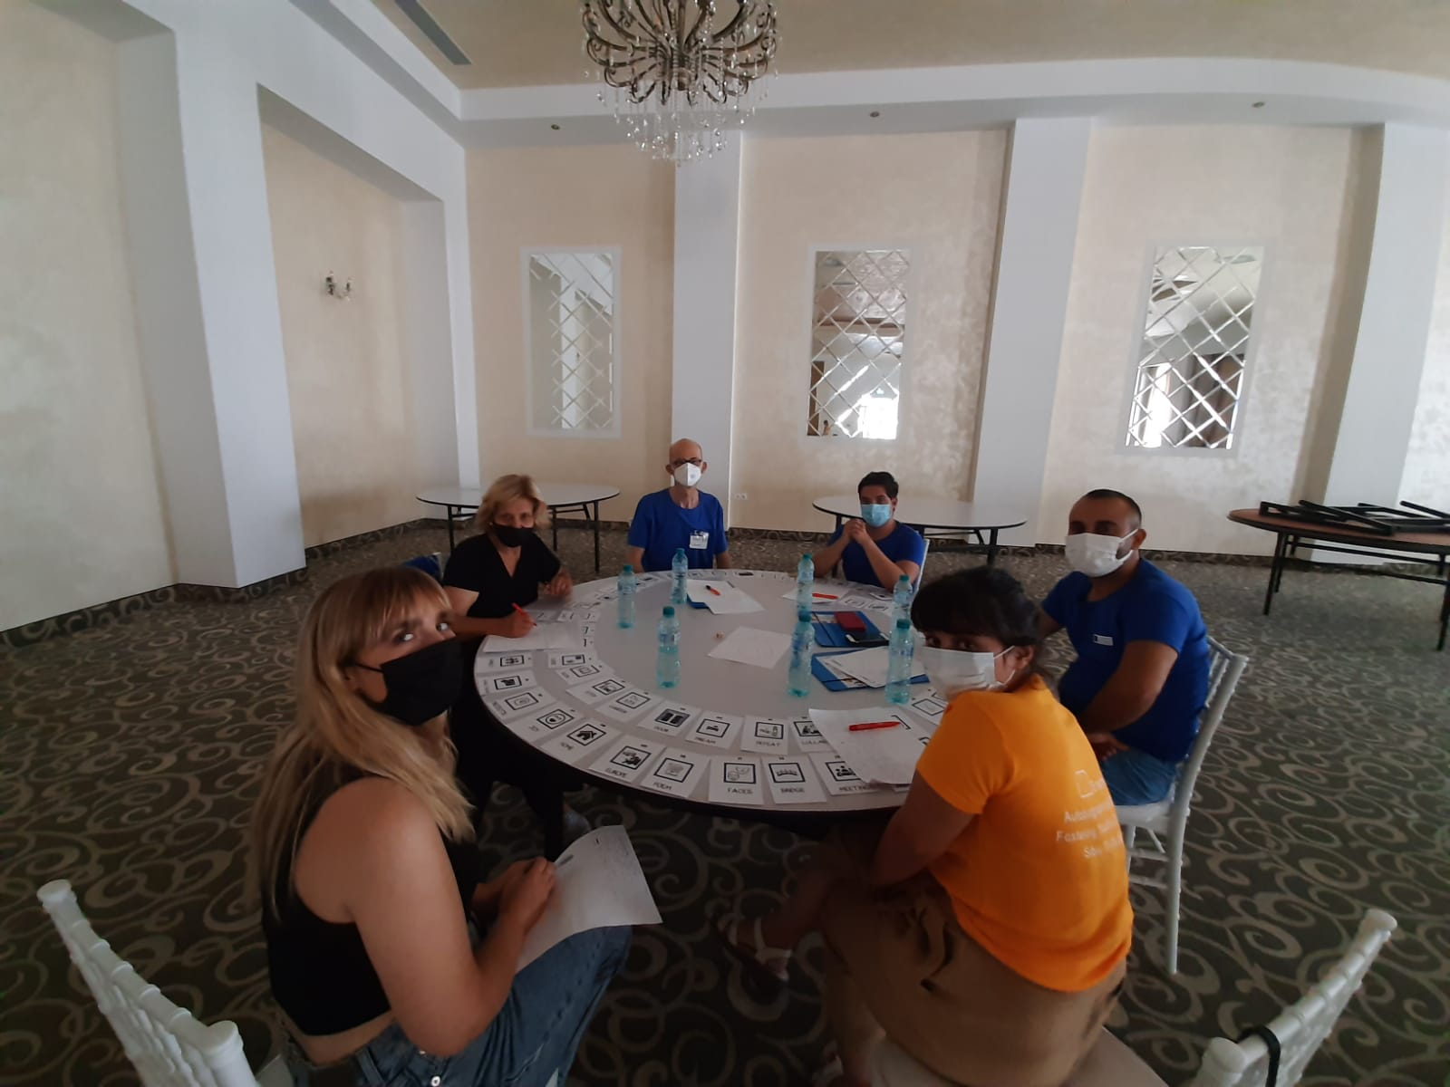
Friends
Image of three women and three men around a table.
Do you remember an episode with some of your friends? Describe.

Slide 50
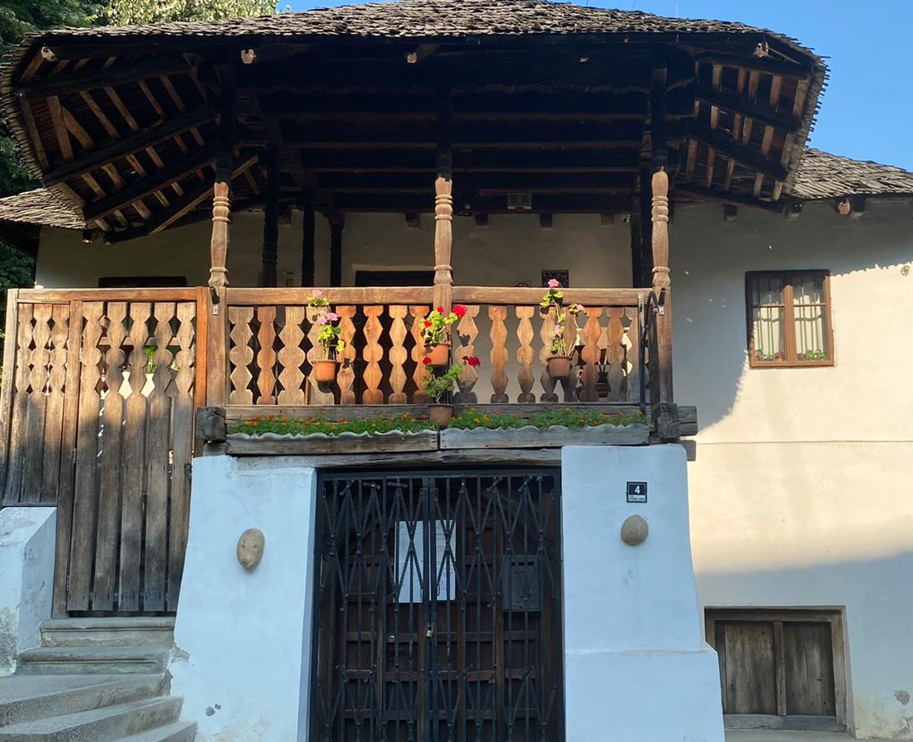
Memorial house
Image of a memorial house with a wooden balcony.
The first time you walked into that house…Were you alone or with someone? Remember your grandparents' house?
Note: Memorial house of Anton Pann, Romanian poet and musician.

Slide 51
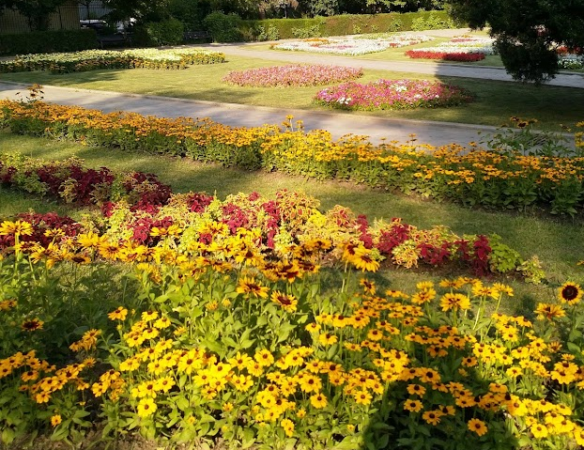
Garden
Image of a garden with flower beds.
Imagine walking in a beautiful garden and smelling the flowers and grass. What comes to mind?
Note : Zăvoi Park in Ramnicu

Slide 52
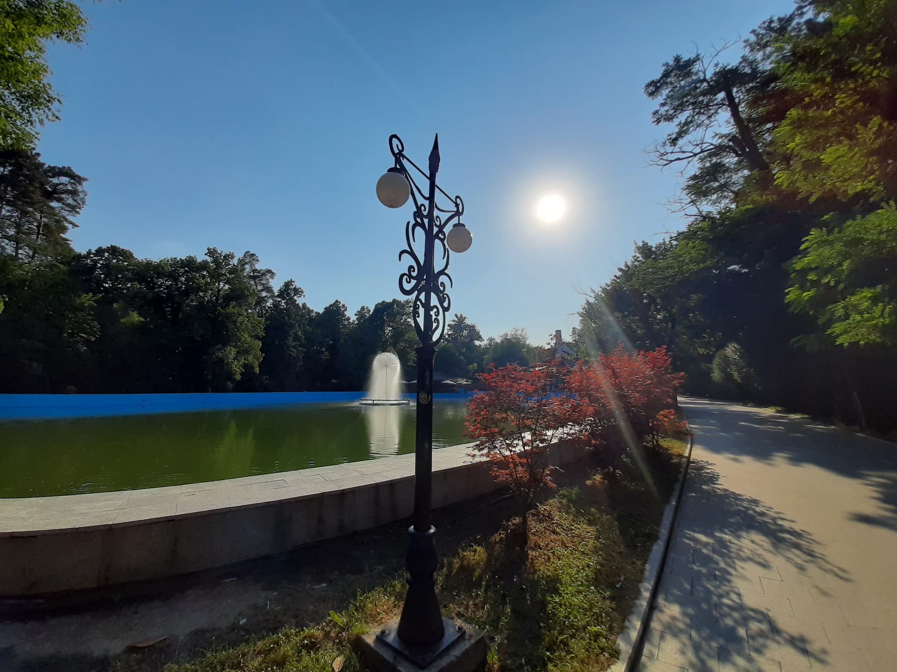
Road
Image of road with trees next to a lake.
Do you remember a road in a park ?
As you walked down that road, you met, touched, heard, did...
Note : Zăvoi Park in Ramnicu

Slide 53
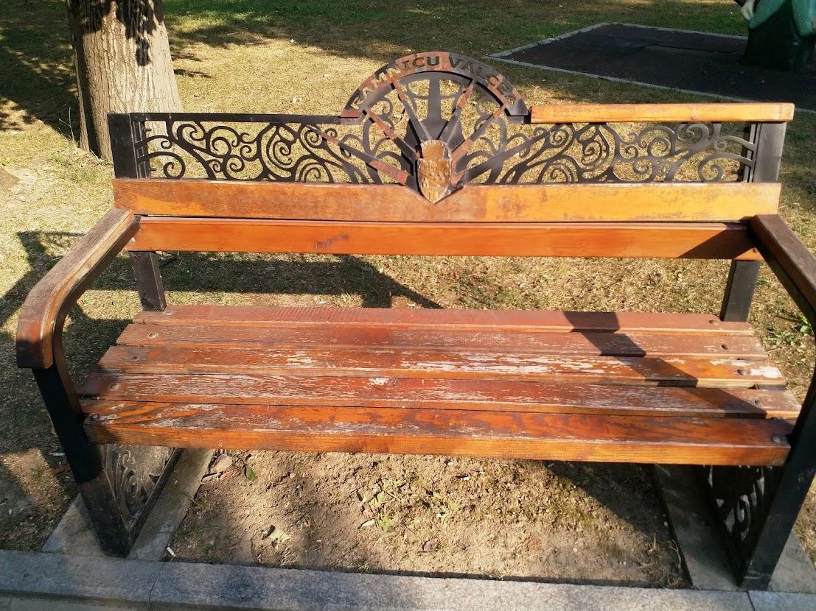
Bench
Image of a wooden bench in a park.
Think about sitting on that bench and thinking, what are you thinking?

Slide 54
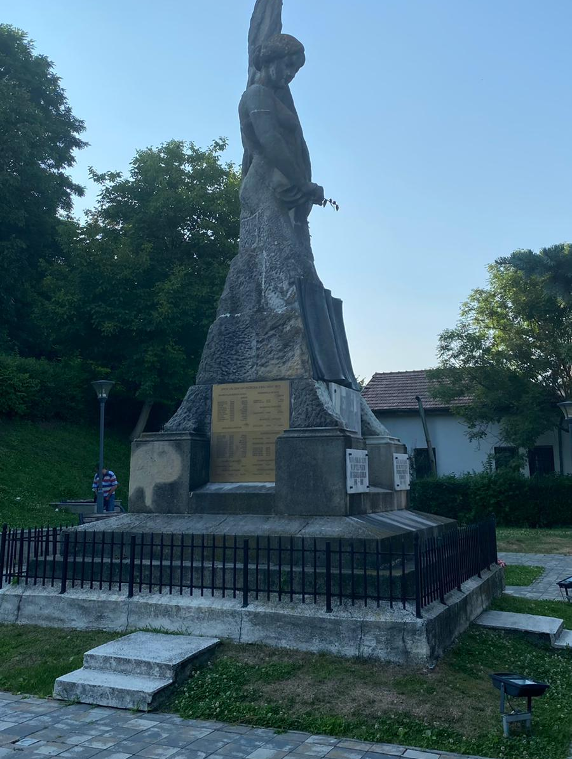
Statue
Image of a statue with a flag. Thinking of a statue, of an important monument, what comes to mind? Where were you?

Slide 55
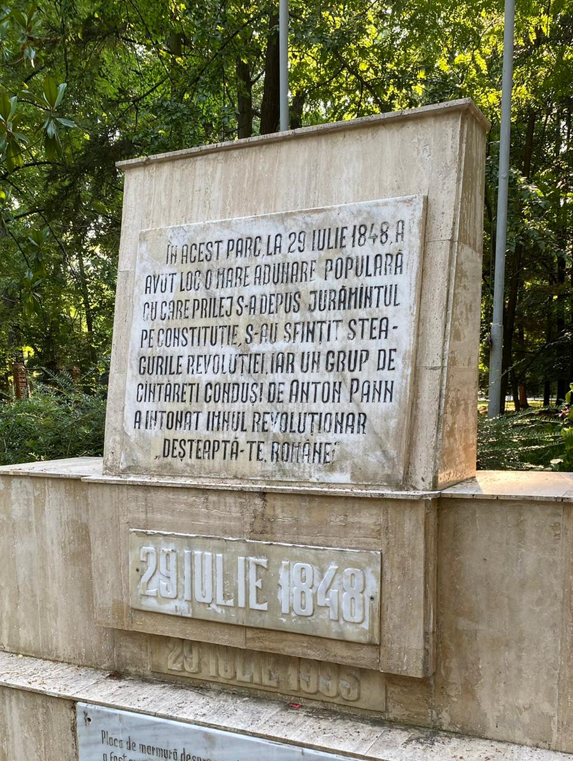
Anniversary
Image of a memorial stone reminiscent of an important historical event on Julie 29, 1848.
If you think of the national anthem and the european anthem, what comes to mind?
Note: the patriotic song was sung for the first time, then the national anthem of Romania. The song was written by the poet Andrei Mureșanu and the music composed by Anton Pann.

Slide 56
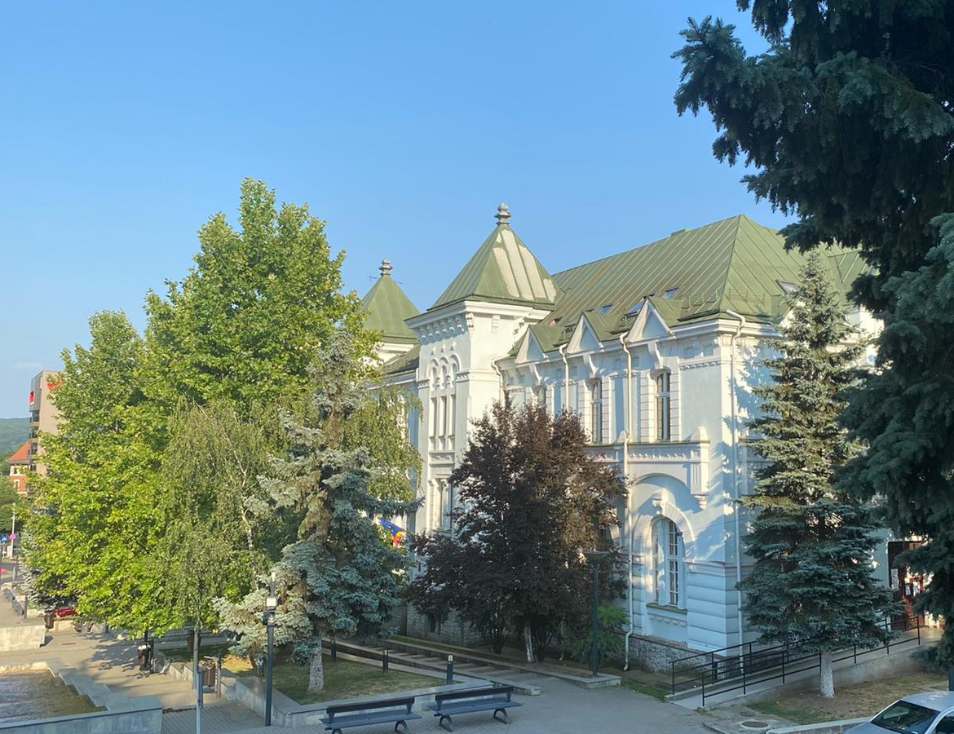
Palace
Image of a large and beautiful palace.
If you think of a large palace what is the first thing that comes to mind?

Slide 57
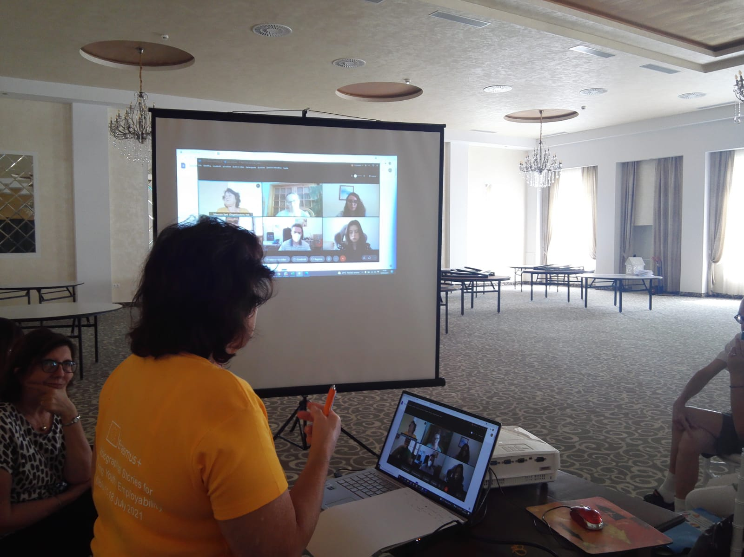
Speaker
Image of a woman speaker speaking in a meeting.
Have you ever found yourself speaking in public? What did you feel?
Can you think of a speaker you liked and one who bored you? Write

Slide 58
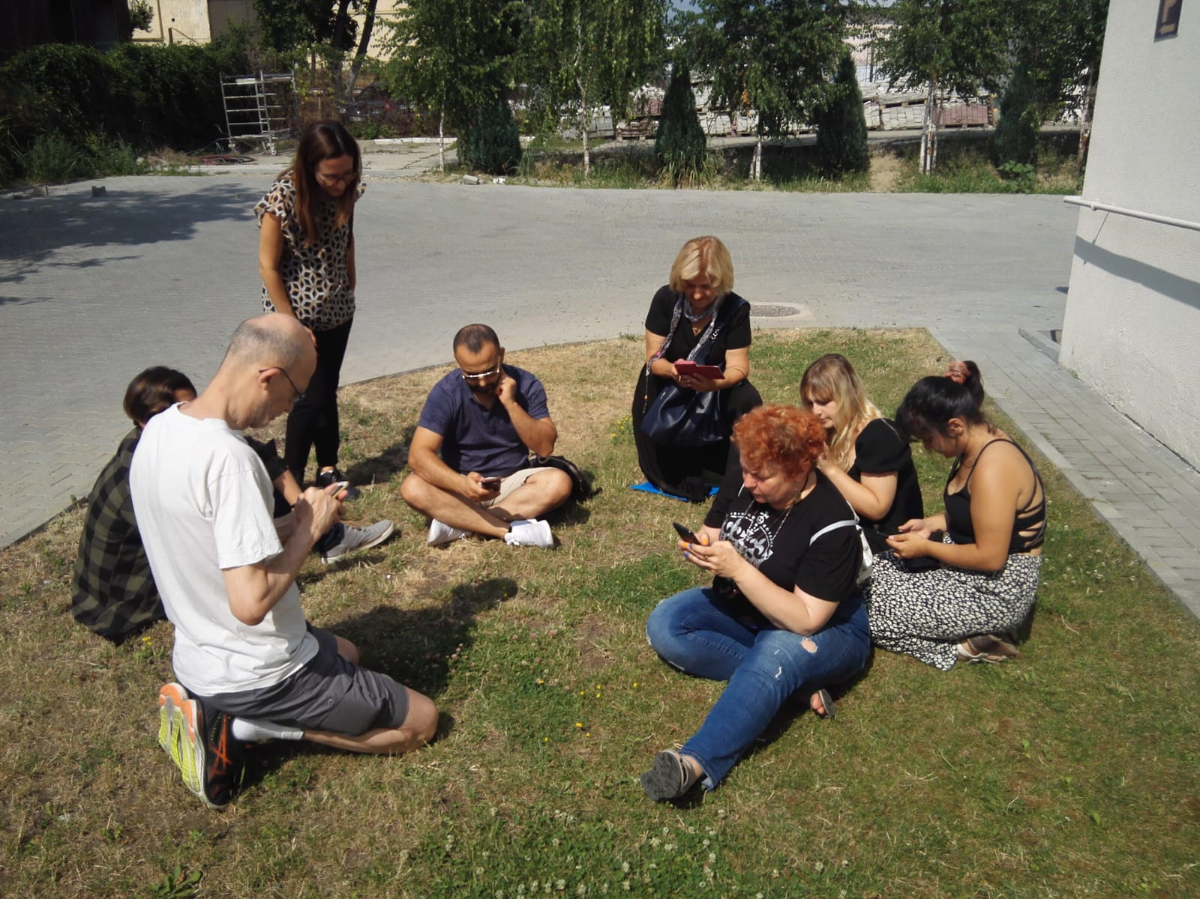
Write together
SOME PEOPLE SITTING ON A LAWN WRITE ON THEIR CELL PHONE WHILE A STANDING MASTER OBSERVES THE GROUP.
IS THERE A PARTICULAR PLACE YOU LIKE WHERE YOU WOULD LIKE TO WRITE YOUR MEMORIES?

Slide 59
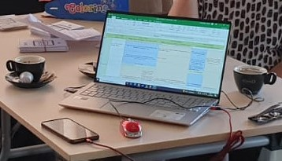
Objects
Image of computer, coffee cups, mobile phone, glasses, playing cards, envelope with colored pencils.
Write a memory on one or more of these objects or write what you want.

Slide 60
Birdhouse
Image of a wooden birdhouse hanging from a tree in a forest.
Which animals do you like the most? Thinking about animals, what comes to mind?
I

Slide 61
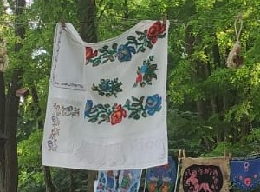
Fabric
Image of fabric embroidered with flowers.
Which fabric do you like the most? Satin, cotton, linen...
Does it remind you of any episode of your life?

Slide 62
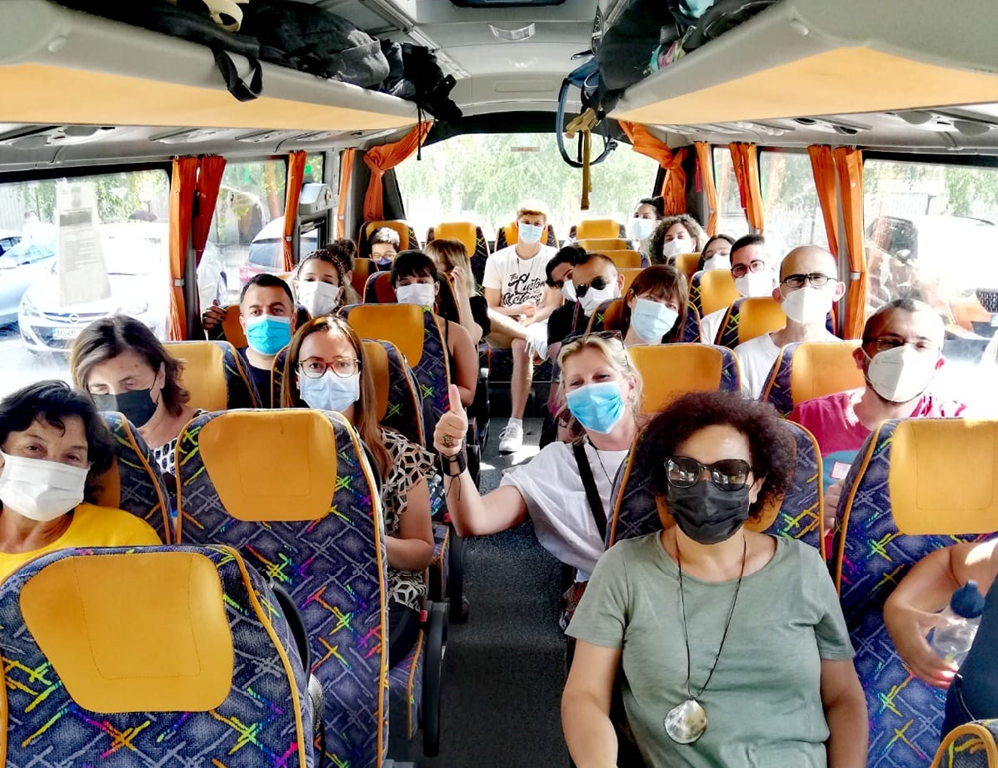
Group Travel
IMAGE OF SEVERAL PEOPLE ON A BUS.
THE FIRST TIME YOU WENT ON A GROUP TRAVEL…

Slide 63
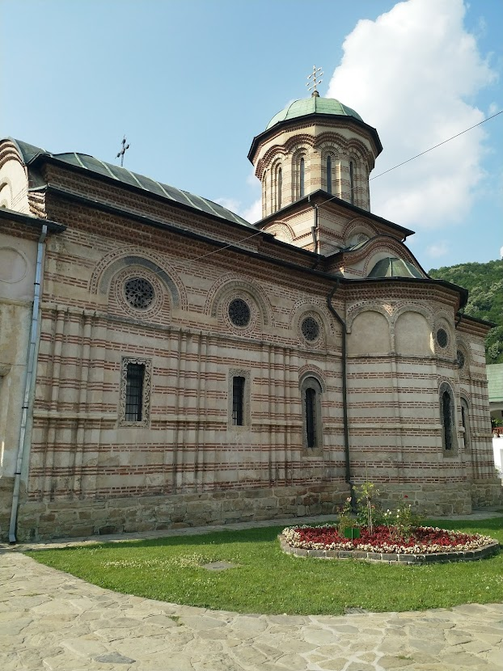
Monastery
Image of an ancient monastery.
The first time you came in…
Note: The monastery of Cozia, national heritage

Slide 64
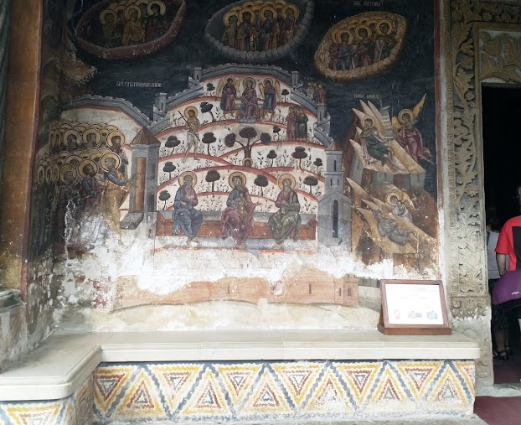
Fresco
Image of a fresco on the church wall.
You are in a silent place, next to a beautiful work of art. Write what your heart tells you.

Slide 65
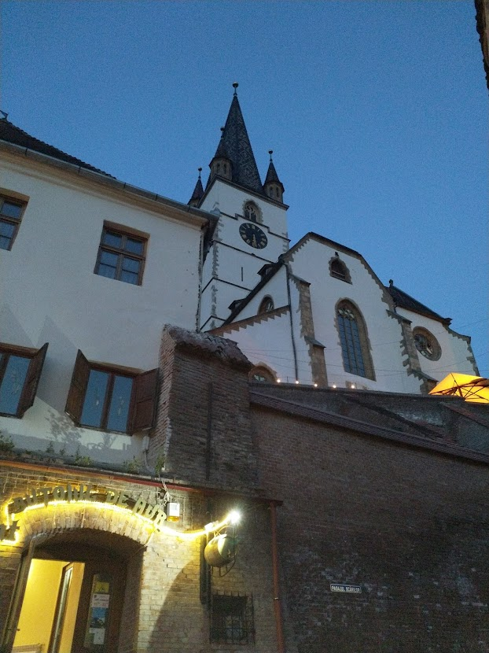
City
Image of a city in the evening when the first lights come on.
Evening, night, landscape, city... what comes to mind?
Note: A walk in the center of the city of Sibiu will take you along narrow alleys, old houses, palaces, churches and towers.

Slide 66
Great Square
Image of a large square with historic buildings.
Can you think of other large squares you have visited? Which country were you in?

Slide 67
Prospect
Image of a person from behind, standing on a boulder, facing a lake.
Desires, expectations, reflections for the future.

Slide 68
Thanks for the attention

